Slide 1

Introductory Computer Networking and IT Security
Week 5

Slide 2
Agenda
Ethernet Switching
STP (Spanning Tree Protocol)
Configuring switches
VLAN Basics
VLAN Trunking Protocols (VTP)

Slide 3
Introduction to Ethernet switching
Hub is a multipoint repeater.
A repeater receives a digital signal, reamplifies or regenerates that signal, then forwards the signal out the other port without looking at any data.
Any digital signal received from a segment on a hub port is regenerated or reamplified and transmitted out all other ports on the hub.
This means all devices plugged into a hub are in the same collision domain as well as in the same broadcast domain.

Slide 4
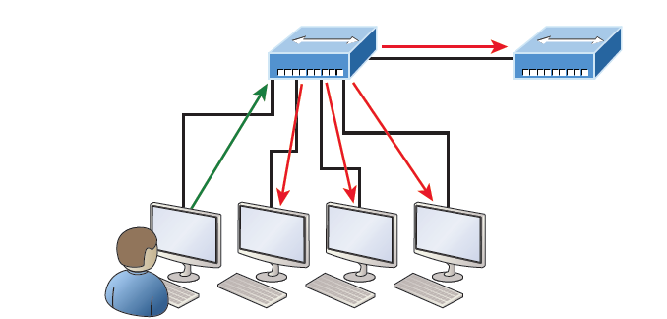
Introduction to Ethernet switching
Working of a hub

Slide 5
Introduction to Ethernet switching
Switch works at data link layer.
Bridges were used to separate collision domain in ethernet networks.
Bridge are software based.
New generation fast switches use application-specific integrated circuits (ASICs).
Switches forward ethernet frames.

Slide 6
Introduction to Ethernet switching
Lists of four important advantages we gain when using Layer 2 switching:
  Hardware-based bridging (ASICs)
  Wire speed
  Low latency
  Low cost

Slide 7
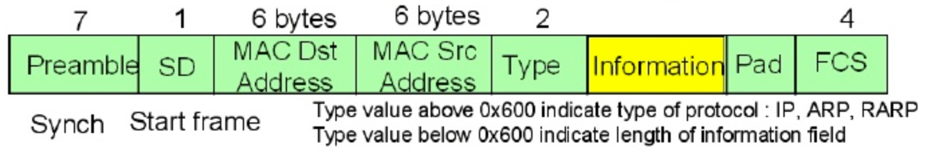
Introduction to Ethernet switching
Below is the structure of a layer 2 frame. Ethernet switches takes decision based on destination MAC address

Slide 8
Introduction to Ethernet switching
Three main functions of a switch
  Address learning
  Forward/filter decisions
  Loop avoidance

Slide 9
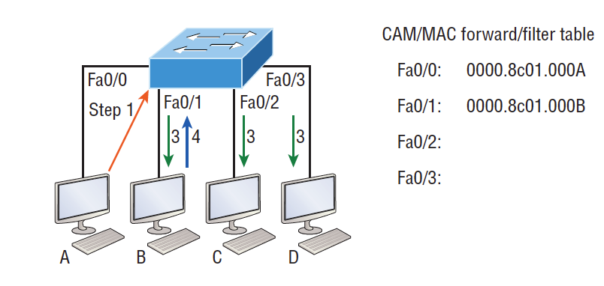
Introduction to Ethernet switching
Address learning
  When a switch is first powered on, the MAC forward/filter table (CAM) is empty.
  When a device transmits and an interface receives a frame, the switch places the frame’s source address in the MAC forward/filter table.

Slide 10
Introduction to Ethernet switching
Forward/Filter decision
  When a frame arrives at a switch interface, the destination hardware address is compared to the forward/filter MAC database. If the destination hardware address is known and listed in the database, the frame is only sent out of the appropriate exit interface.
  If the destination hardware address isn’t listed in the MAC database, then the frame will be flooded out all active interfaces except the interface it was received on.

Slide 11
Introduction to Ethernet switching
Loop Avoidance
  Redundant path in the switching network create a loop
  Loop will create problems like
    Broadcast Storm
    Multiple frame copies
    CAM table thrashing
  Spanning Tree Protocol is used to avoid loop in ethernet switched networks

Slide 12
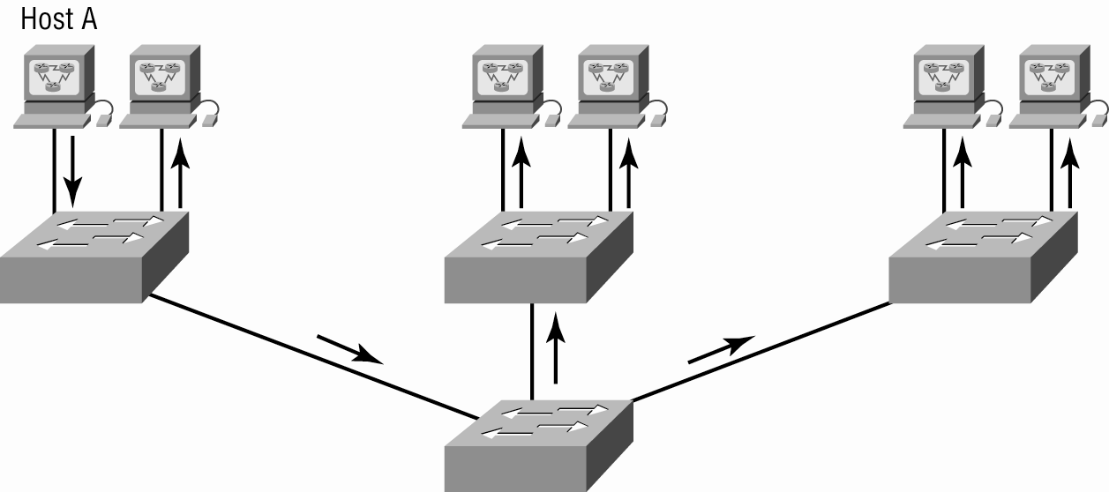
Introduction to Ethernet switching
Typical ethernet switch network

Slide 13
Spanning Tree Protocol (STP)
All Cisco switches run the IEEE 802.1D version of STP, which isn’t compatible with the DEC version.
STP’s main task is to stop network loops from occurring on your layer 2 network (bridges or switches).
It vigilantly monitors the network to find all links, making sure that no loops occur by shutting down any redundant links.
STP uses the spanning-tree algorithm (STA) to first create a topology database, then search out and destroy redundant links.

Slide 14
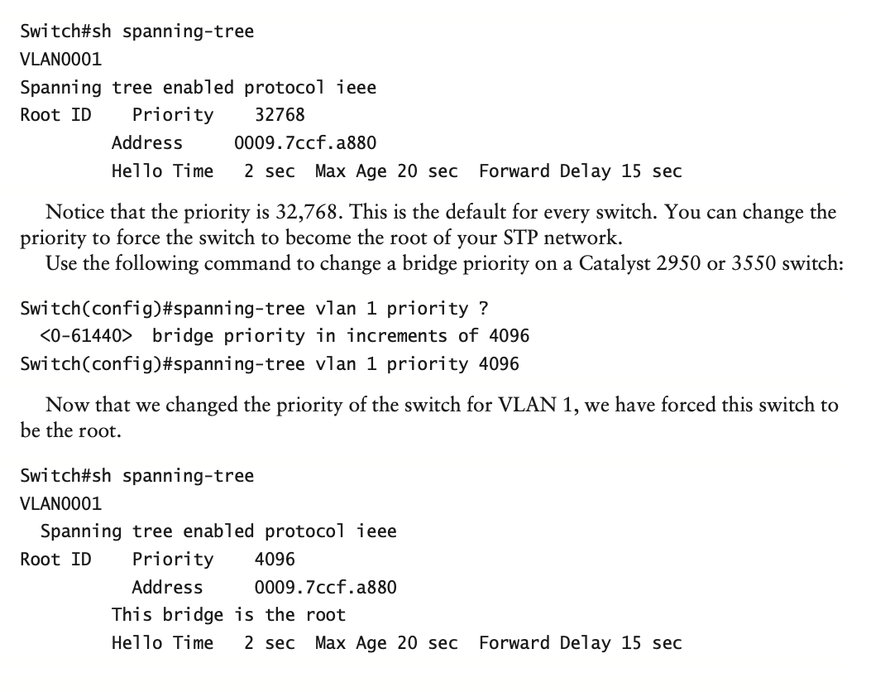
STP Terminology
Root bridge
BPDU
Bridge ID
Non root bridge
Root port
Designated
Port cost
Non designated port
Forwarding port
Blocked port

Slide 15
Configuring switches
Setting the passwords
Setting the hostname
Configuring the IP address and subnet mask
Setting a description on the interfaces
Setting port security
Erasing the switch configurations

Slide 16
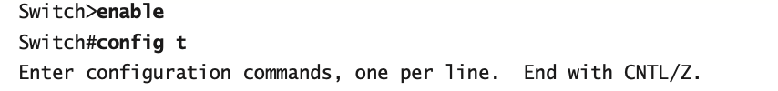

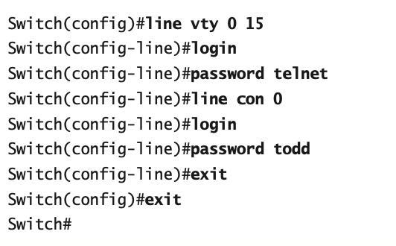
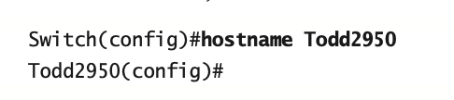

Slide 17
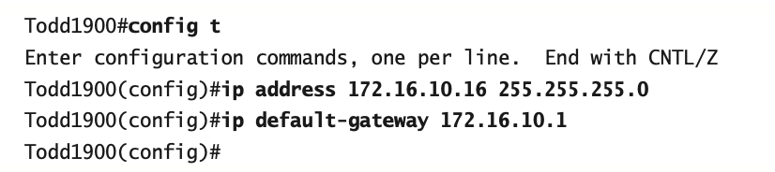
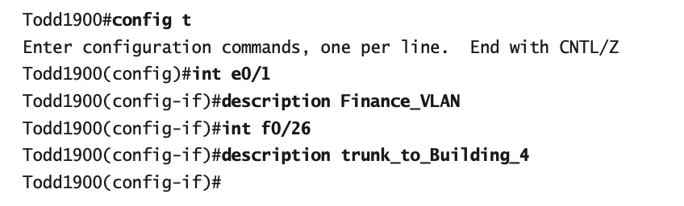
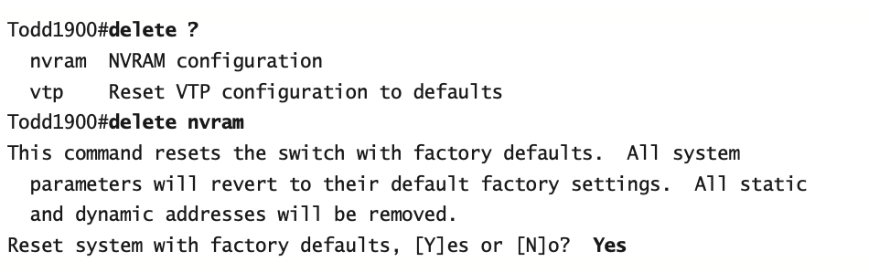

Slide 18
VLANs
Layer 2 switches create a flat network.
Its by default does not break up broadcast domain.
Virtual LAN (VLANs) are used to break broadcast domain.
Logical port group is created in a switch.
Security can be implemented by segregating the network.
Network adds, moves, and changes are achieved with ease by just configuring a port into the appropriate VLAN.

Slide 19
VLANs
Static VLANs
  Typical method of creating VLANs
  Most secure
  A switch port assigned to a VLAN always maintains that assignment until changed.

Slide 20
VLANs
Dynamic VLANs
  Node assignment to a VLAN is automatic
  MAC addresses, protocols, network addresses, etc
  VLAN Management Policy Server (VMPS)
  MAC address database for dynamic assignments
  MAC-address to VLAN mapping

Slide 21
VLANs
Identifying VLANs
  Access links
    A link that is part of only one VLAN
  Trunk links
    Carries multiple VLANs

Slide 22
VLANs
Frame Tagging
  A means of keeping track of users & frames as they travel the switch fabric & VLANs
    User-defined ID assigned to each frame
    VLAN ID is removed before exiting trunked links & access links

Slide 23
VLANs
    Two tagging methods are used
  Inter-Switch Link (ISL)
    Cisco proprietary
  IEEE 802.1q
    Open standard defied by IEEE

Slide 24
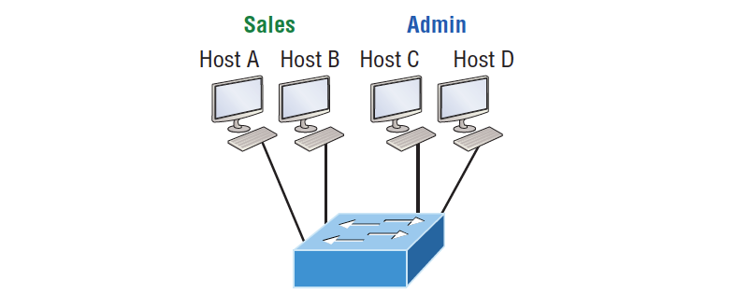
VLANs
Typical VLAN implementation on a single switch

Slide 25
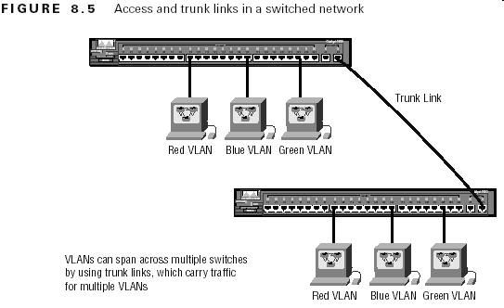
VLANs
Typical VLAN implementation on a multiple switch

Slide 26
VLAN Trunking Protocol (VTP)
The goals of VLAN Trunking Protocol (VTP) are to manage all configured VLANs across a switched internetwork.
Consistent VLAN configuration across all switches in the network.
VLAN trunking over mixed networks, such as Ethernet to ATM LANE or even FDDI.
Accurate tracking and monitoring of VLAN.
Dynamic reporting of added VLANs to all switches in the VTP domain
Plug-and-Play VLAN adding.

Slide 27
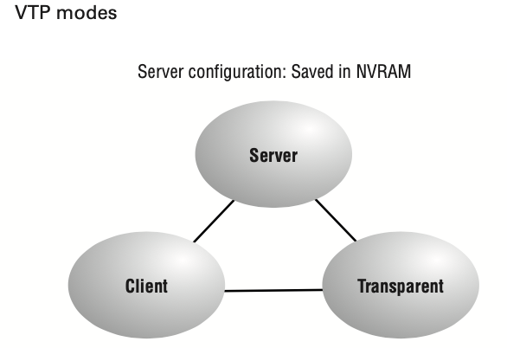

Slide 28
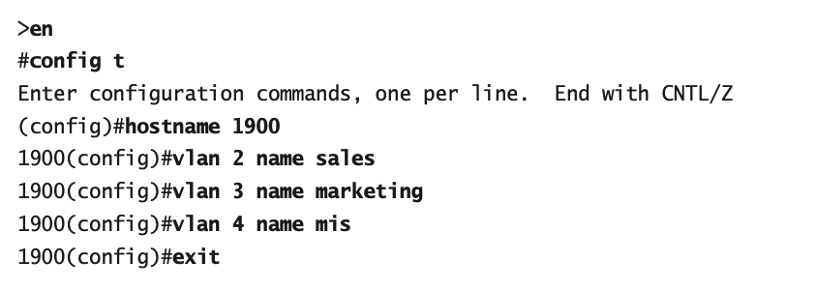
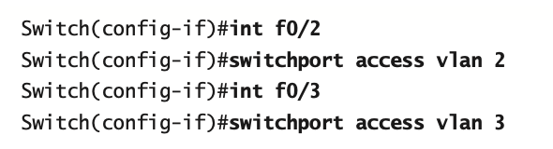
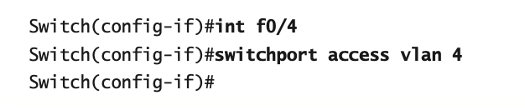
Configuring VLANs
Assigning Switch Ports to VLANs

Slide 29
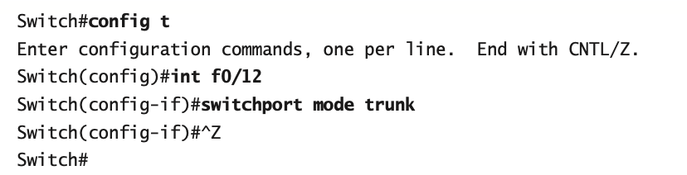
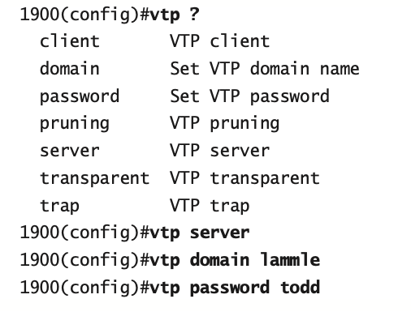
Configuring Trunk Ports
Configuring VTP

Slide 30


Slide 31
THANK YOU

